Slide 1
Medical research and innovation: where to look?
Wei Lu, Todd Rachowin, Yingying Xu, Zhe (Alan) Yu
April 18, 2017
Notes:
"Where" is meant to be general and refers not only to specific locations, such as cities/states, but also specific diseases, such as diabetes, and other characteristics.

Slide 2
Agenda
Introduction
General Analysis
City Analysis
Ranking and Conclusion

Slide 3
Key Question: where are the best places for health research and innovation?
Where: can refer to
Types of diseases
How it’s changed overtime
Physical locations
Motivating Facts:
The National Institute of Health (NIH) has granted over $90B in the last 4 years
Example - Houston: $610M from 1,300 grants in 2016
Over 1000 early stage companies have received VC funding since 2000
Notes:
A lot of money (over $20B every year); And also Houston is close to Medical Center

Slide 4
We started by trying to understand what were the major trends, and then focused on a main leverage point: location (specifically city)
General Analysis: Where can we dive deep? What is important?
What are the trends:
Specific diseases
Time trends
Locations
Specific analysis → locations → cities → what differentiates them?
“Access to talent”
“Access to funding”
“Access to resources”
Ranking

Slide 5
We used 5 main data sources:
NIH (the National Institute of Health), 1995,2000,2005,2010, and 2012-2016
From 2013 to 2016, the NIH grants > $90B for medical research
Thomson One VentureXpert, 2000-2016
Venture capital for startups - Medical Devices and Equipment, Healthcare Services, Biotechnology
AHR (America’s Health Rankings), 2015
Cancer/Cardiovascular Death rate, Diabetes/Obesity rate in each state
Kaiser Family Foundation, 2016
Total Professionally Active Physicians, and Hospitals
Top 100 Universities in the U.S., 2016 (US News)

Slide 6
Agenda
Introduction
General Analysis
“Where can we dive deep?”
City Analysis
Ranking and Conclusion

Slide 7
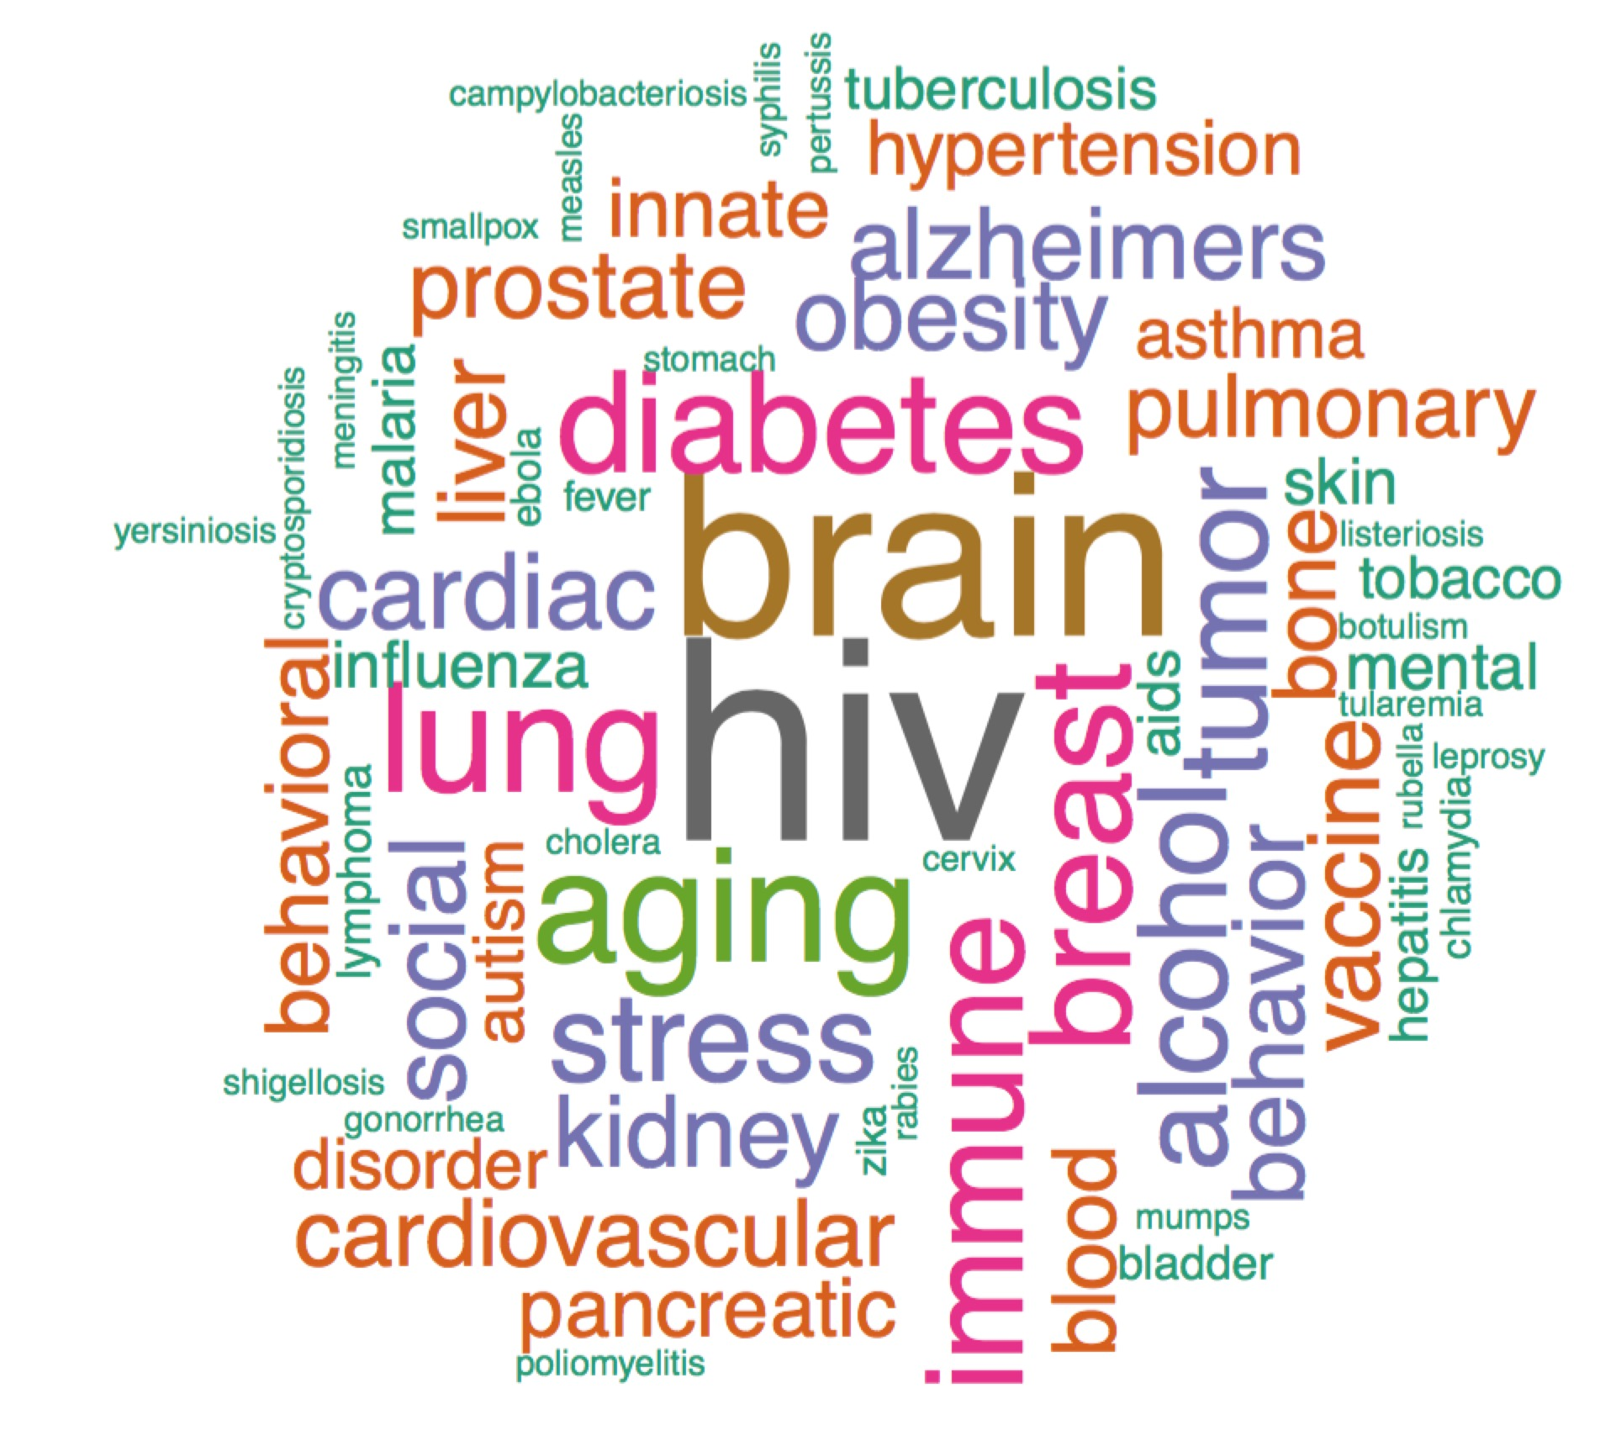
Start with diseases: large amount of NIH funding goes to HIV, brain, aging and diabetes related issues
*Excludes cancer
Notes:
The word cloud shows that in 2016, most NIH projects were focused on the area of brain, HIV, aging, diabetes and lung.

Slide 8
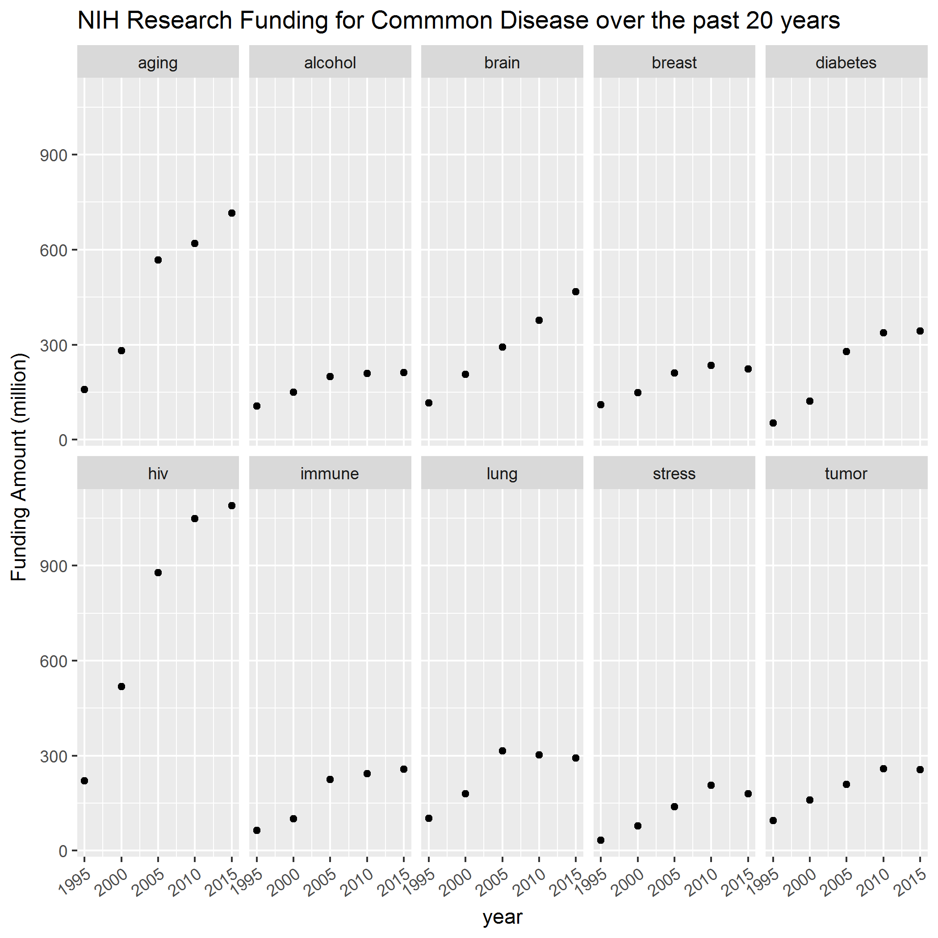
Next, time: funding for diseases generally trends with the total NIH funding, but HIV, aging and brain continue to receive high funding regardless
Notes:
Follow the NIH budget.

Slide 9
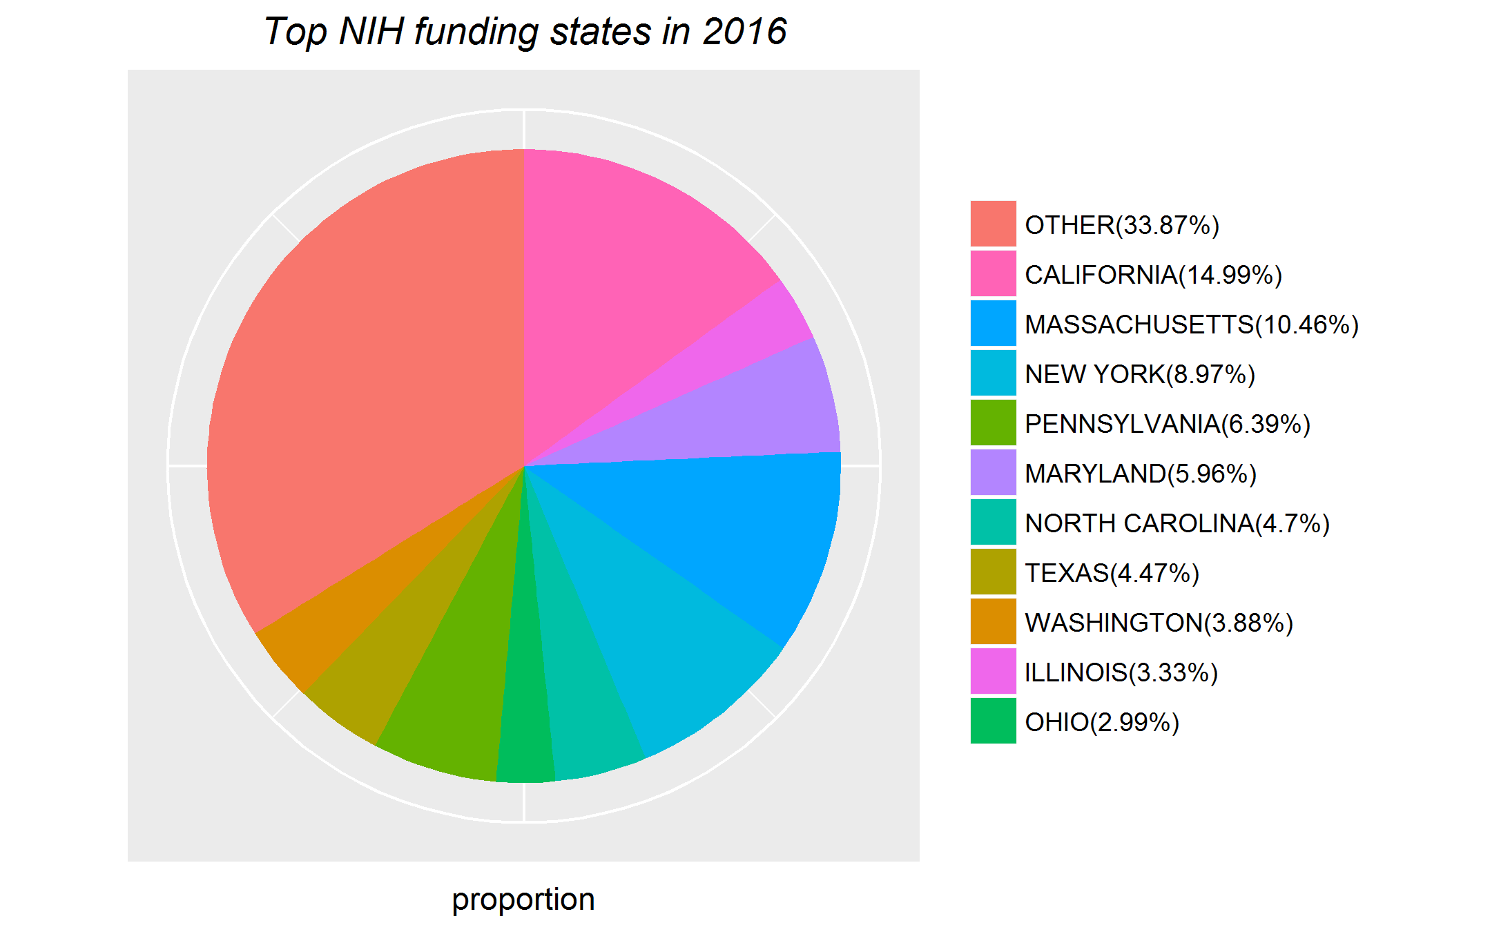
Now location: California, Massachusetts, and New York have the highest amounts of funding, with the top10 account for over 66% of funding.

Slide 10
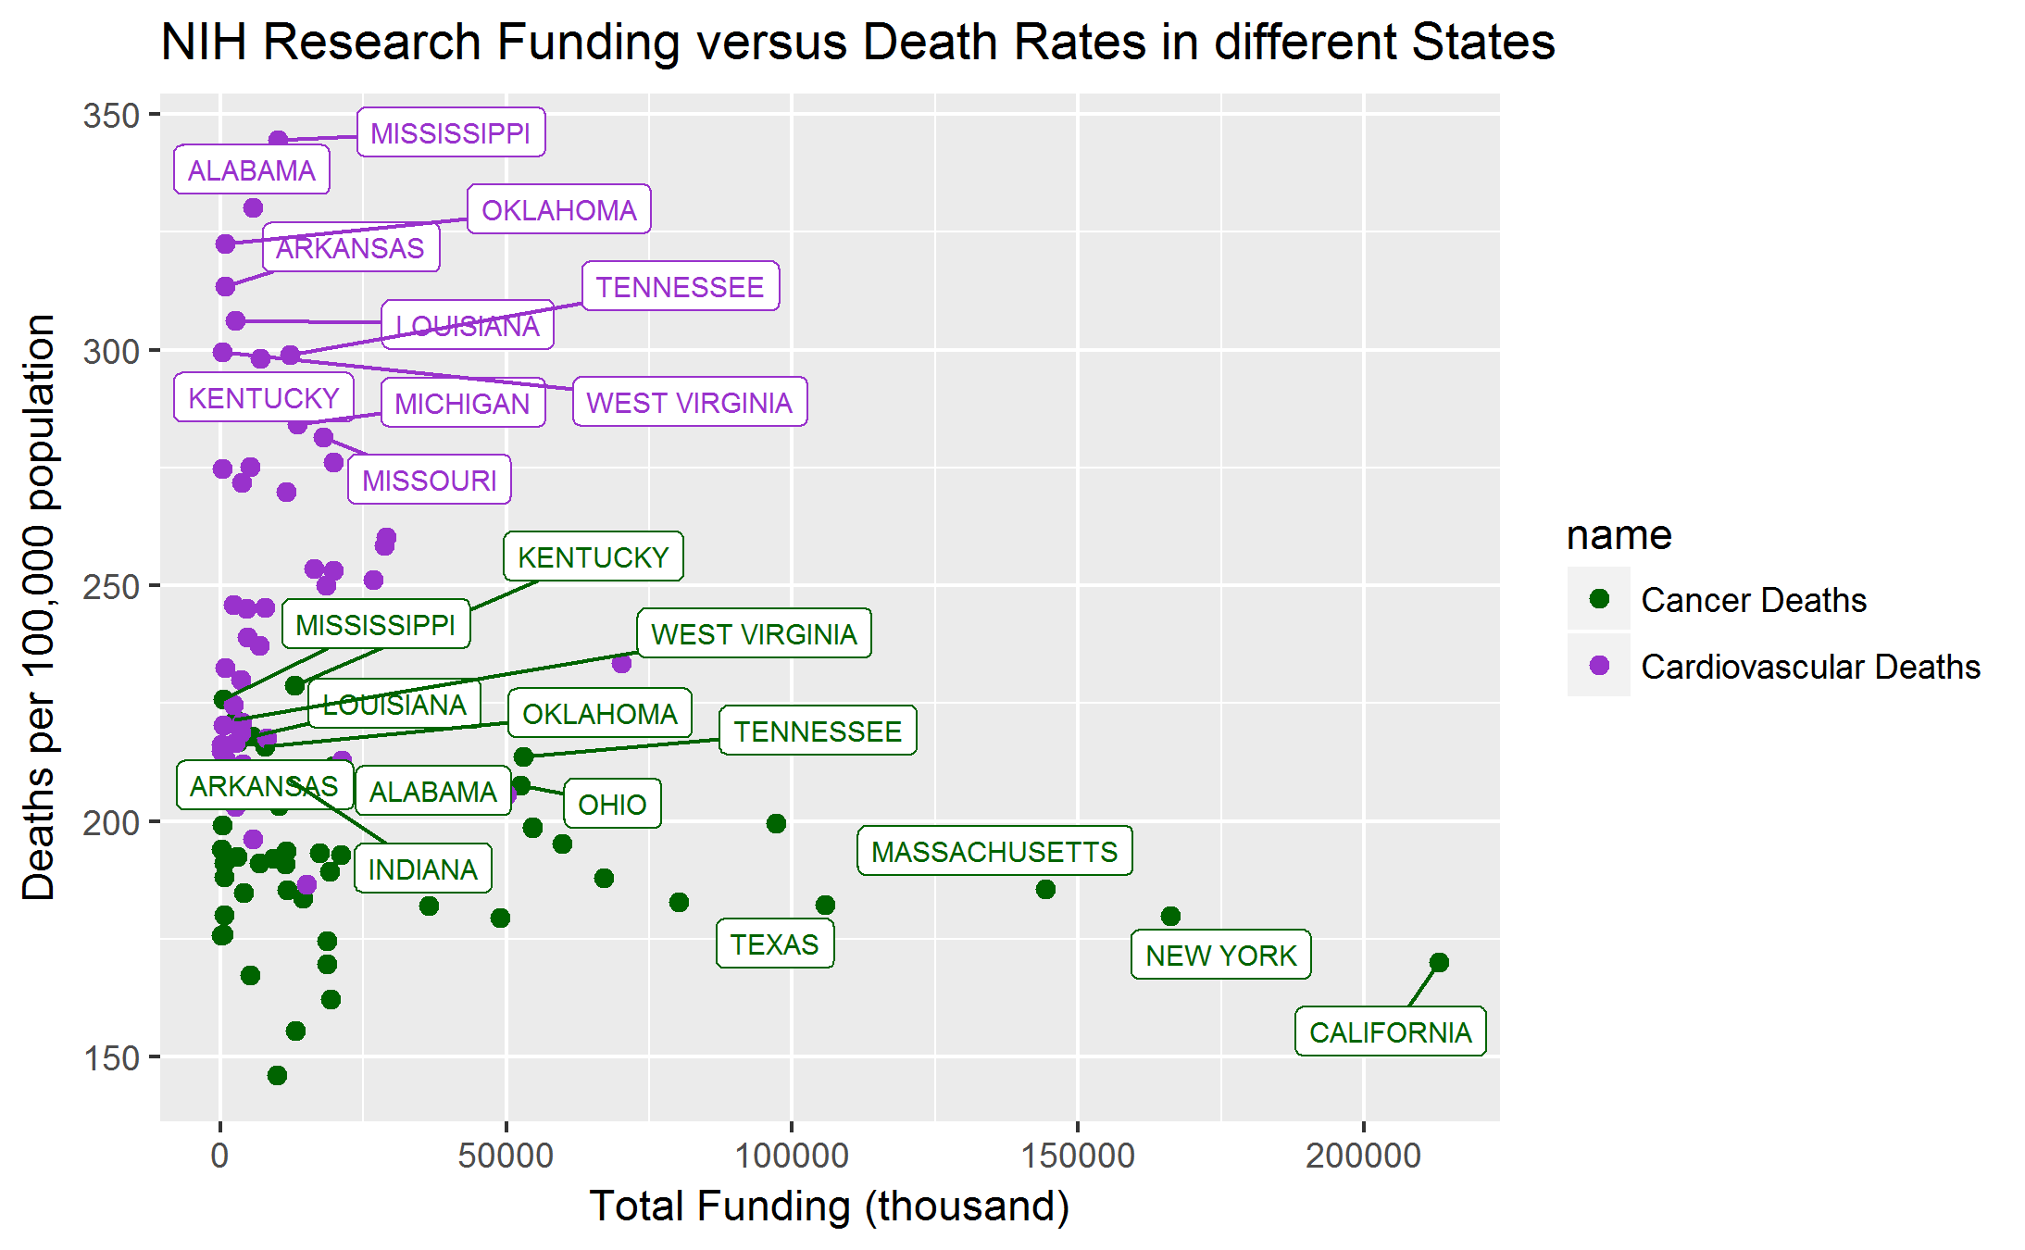
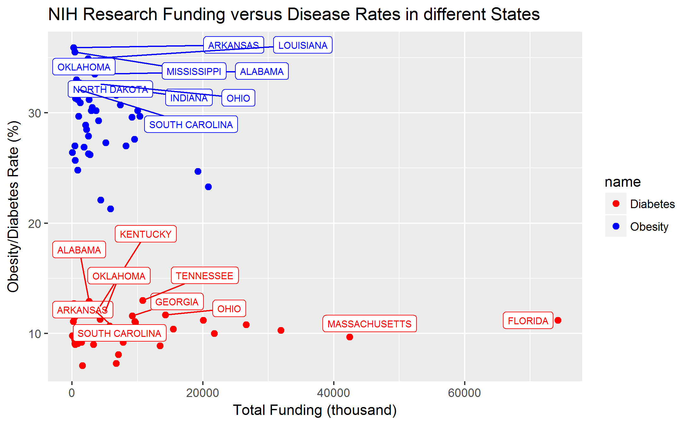
Comparing with incidences of diseases: funding are more likely to go to those states with more research institutes/universities/hospitals; AND the research focus is not highly consistent with the death/disease rate.
Notes:
No correlation between the funding and how high is the disease rate.
Is the disease rate related to funding amount? Does those disease with higher death rate have higher attention?

Slide 11
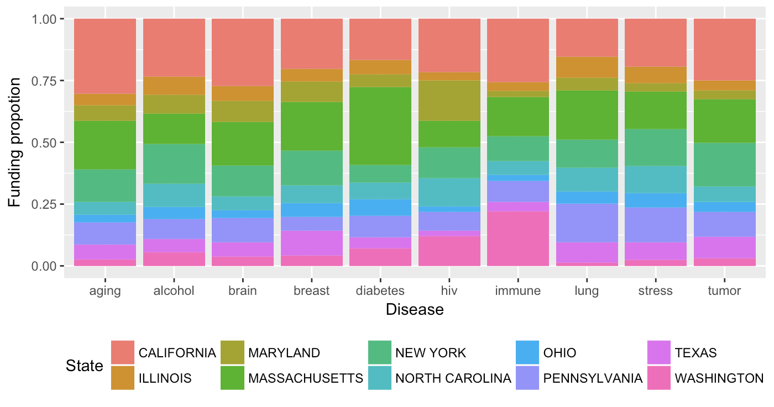
And, states may (not) specialize in specific diseases

Slide 12
Agenda
Introduction
General Analysis
City Analysis
“What differentiates cities?“
Ranking and Conclusion

Slide 13
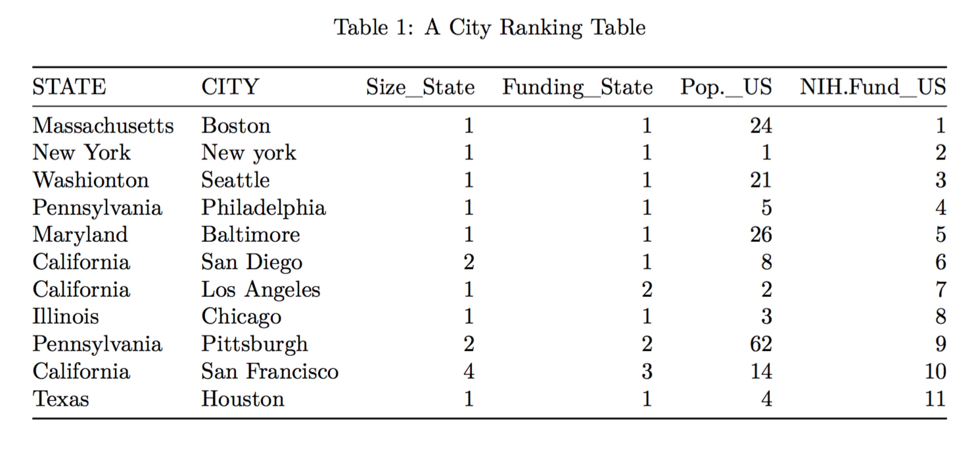
States → Cities: The largest cities by population per state are also the most funded
Notes:
We notice the large cities in the state account for large amount of the funding.
We first chose top 100 cities that have satisfied size ranking within state(1,2,3) based on population of the cities, then we pick the first 11 cities based on their combined ranking(size, funding both in state and the US). We can see that city size in one state is positively related to the funding size within one state, however, does not match the funding size exactly.

Slide 14
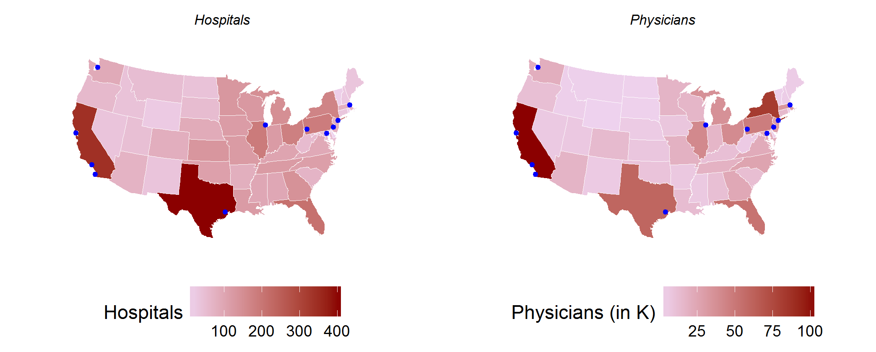
Access to Resources: Cities in the largest states have access to the highest number of physicians and hospitals (TX, NY, CA), but that does not necessarily translate to cities (FL)
Hospital & Physicians by State (2016)
Notes:
Texas has over 400 hospitals and California has the highest number of professionally active physician (>103k).
No highly funded city in Florida.

Slide 15
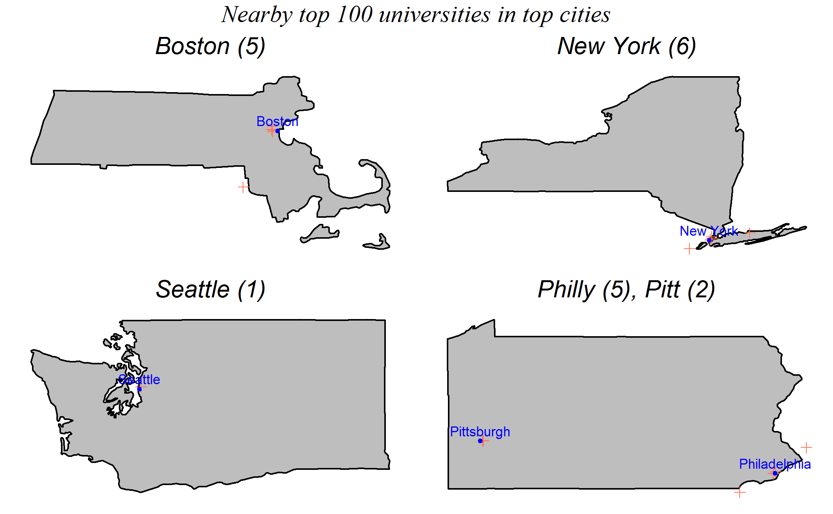
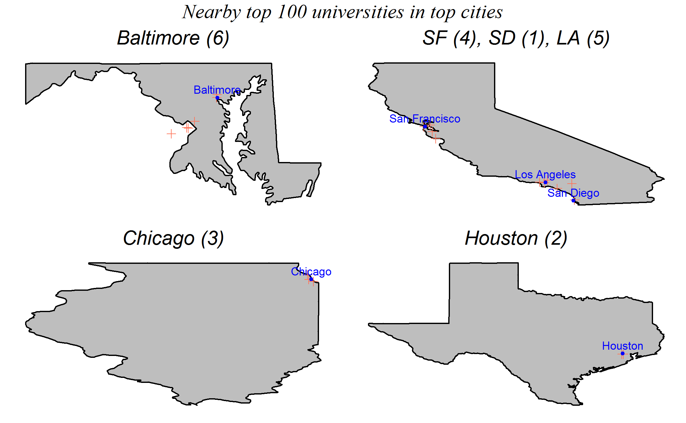
Access to Talent: there is not a significant difference in the number of top 100 schools near the cities - both Boston and New York have 2 of the most schools
Notes:
As expected, there is not a significant difference in the number of top 100 universities near the cities, but both Boston and New York, 2 of the most NIH funded cities, have two of the highest number of nearby universities.

Slide 16
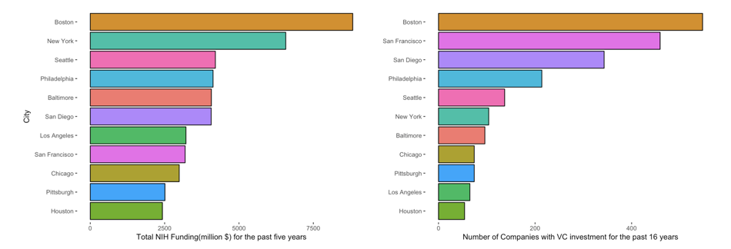
Access to Funding: Boston and New York receive a disproportionately high amount of NIH funding, while Boston, SF, and San Diego have a disproportionately high number of companies that receive VC funding

Slide 17
Agenda
Introduction
General Analysis
City Analysis
Ranking and Conclusion

Slide 18
We rank cities based on three criteria: access to talent, funding, and access to resources
Talent
Funding
Resources
Top universities
NIH
Venture Capital
State Hospitals
State Physicians
Rank per Category → create an aggregated score
Notes:
three dimensions previously discussed: access to talent, access to resources, and access to funding.
Ranking: we average the rankings within each dimension

Slide 19
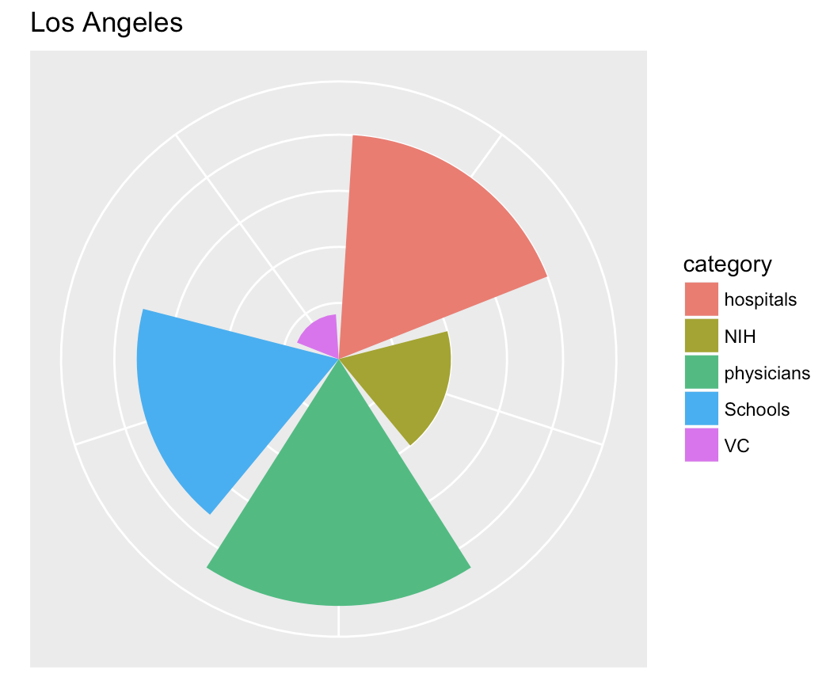
Sample ranking per city (here Los Angeles)
Notes:
Larger the block, the higher the rank.

Slide 20
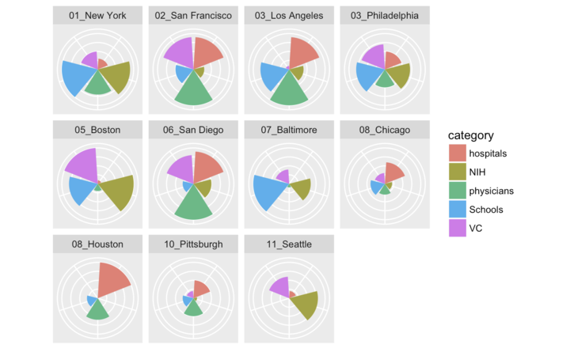
Based on our ranking, NY and SF are the best places for medical research, while Seattle ranked lowest for the selected cities
Notes:
New York is the highest ranked, while Seattle is the lowest.

Slide 21
Concluding Remarks
Based on our results, NY is the best city for medical research, but there are significant opportunities to improve our ranking:
Fix number of hospitals/physicians
Focus on cities for specific diseases
Etc.
There are also really interesting trends in medical research beyond city-level
Focus on Cancer, HIV, Brain, and Aging
Funding not necessarily going to the highest instances of a disease
Notes:
2 disease get funding consistent over time

